Slide 1

Grow Your Business Website
Current Functionalities & Proposed Edits

Slide 2
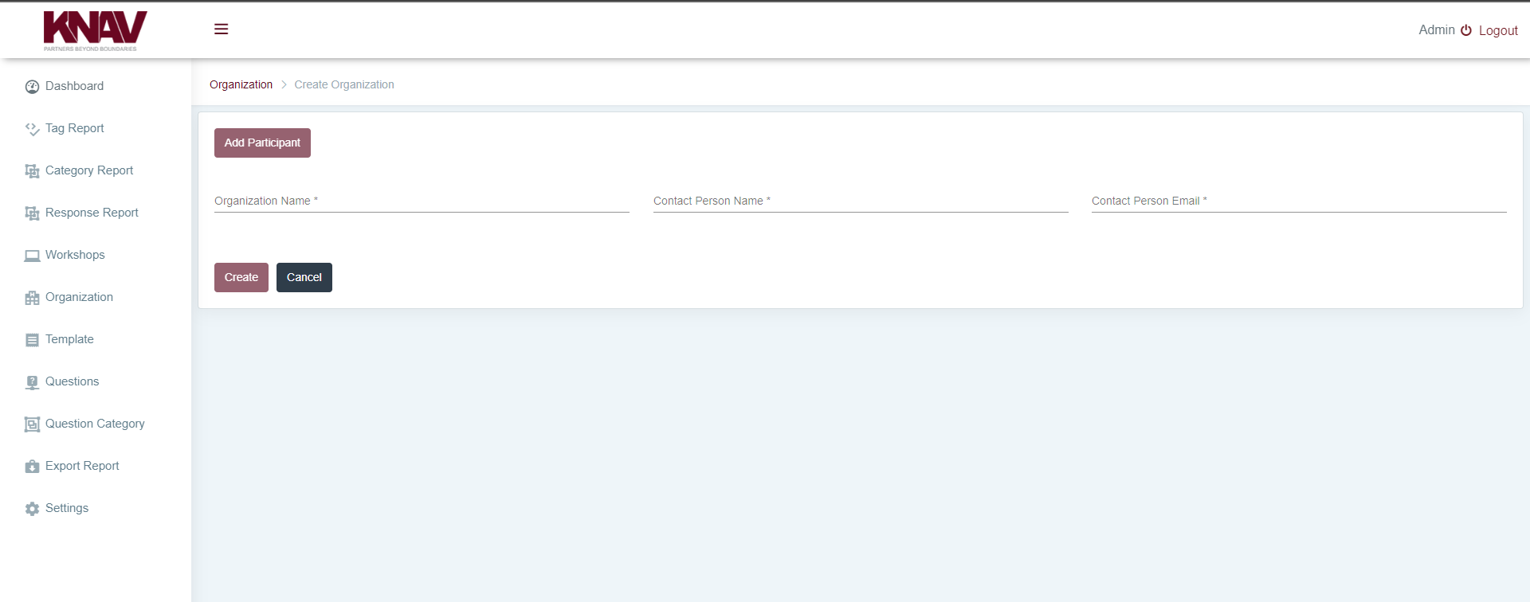
Adding Participants to a Workshop
1
Participant Details in Workshop as opposed to Organization
Existing Functionality and Restrictions
1. At present, participants’ details form a part of the organization.
Proposed Functionality and Features
1. Going forward we wish to have participants’ details shifted from Organization to Workshop. This is to solve for our proposal of having multiple workshops from the same organization. Consequently, responsibility centres could be different for each workshops.

Slide 3
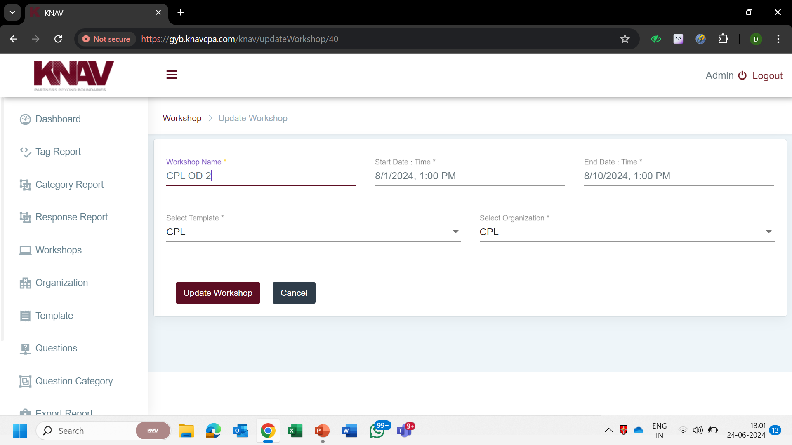
Workshop Creation
1
Prior to Workshop Commencement Date
Existing Functionality and Restrictions
1. We can edit all of the available options.
Proposed Functionality and Features
1. Existing functionality should be retained.

Slide 4
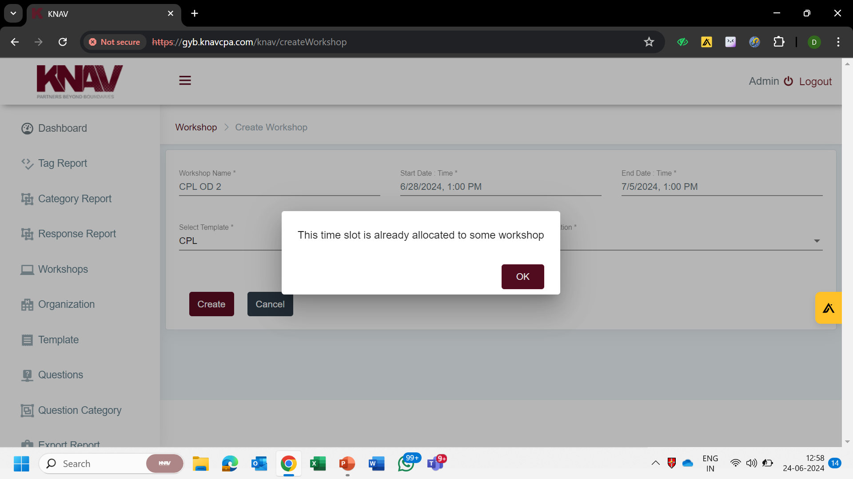
Workshop Creation
2
Overlapping Dates of >1 Workshop
Existing Functionality and Restrictions
1. More than one workshop cannot run simultaneously if their timeframes overlap each other.
Proposed Functionality and Features
1. Considering the fact that the team could be working on two workshops simultaneously, creation of multiple workshops parallelly should be an option. In addition, we also desire a functionality wherein workshops of two different organizations can run parallelly.

Slide 5
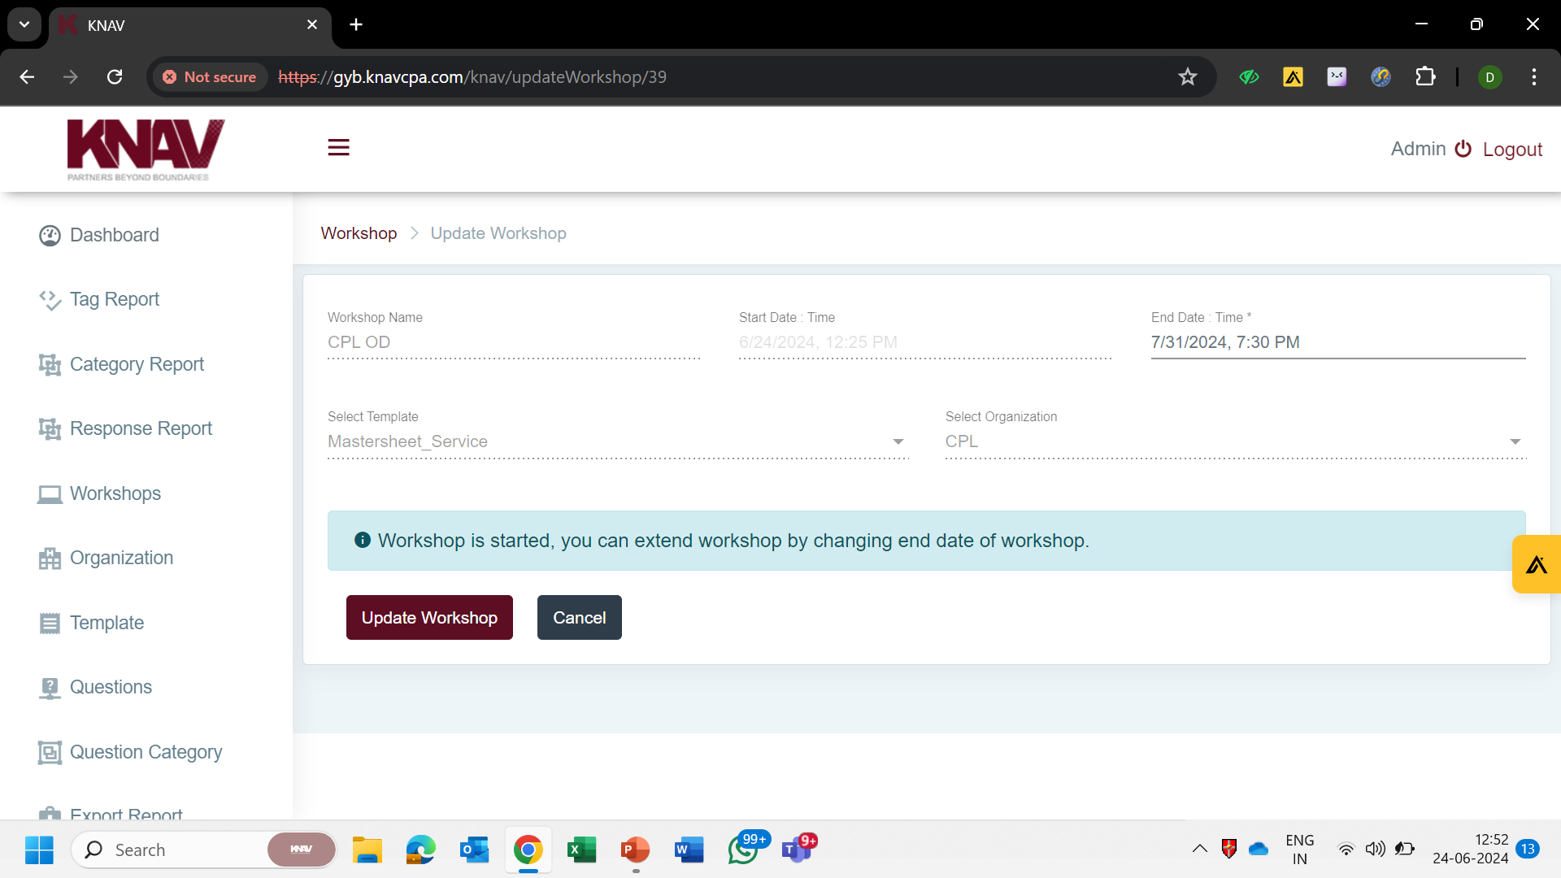
Workshop Creation
3
Post Workshop Commencement Date
Existing Functionality and Restrictions
1. We cannot edit any detail other than workshop conclusion date.
Proposed Functionality and Features
1. Editing access should be expanded to all options.

Slide 6
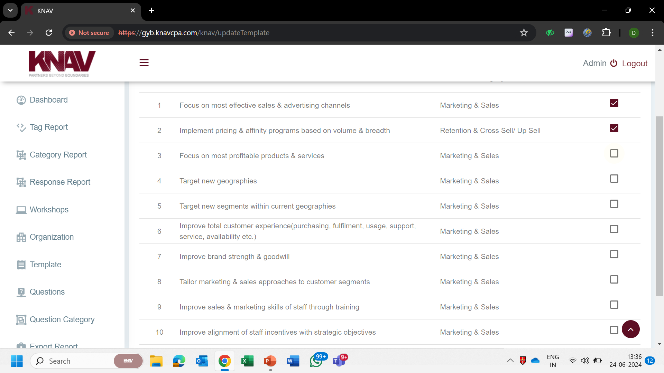
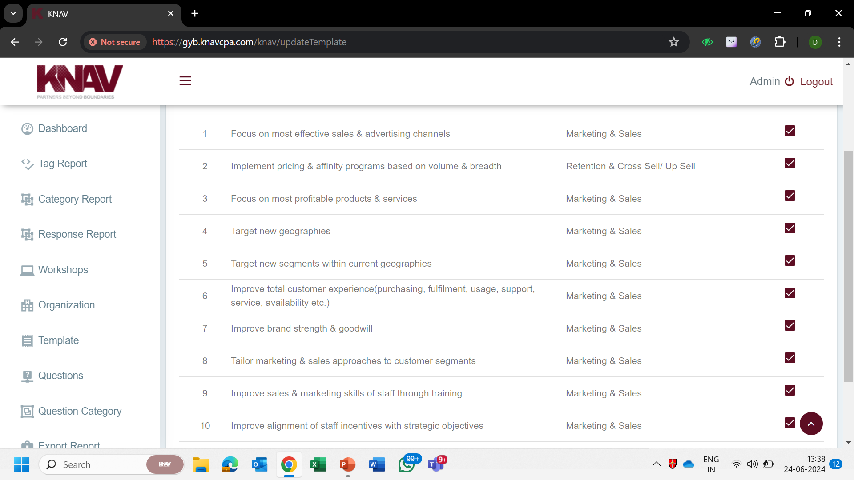
Questionnaire
1
Addition of Questions in a Template

Slide 7
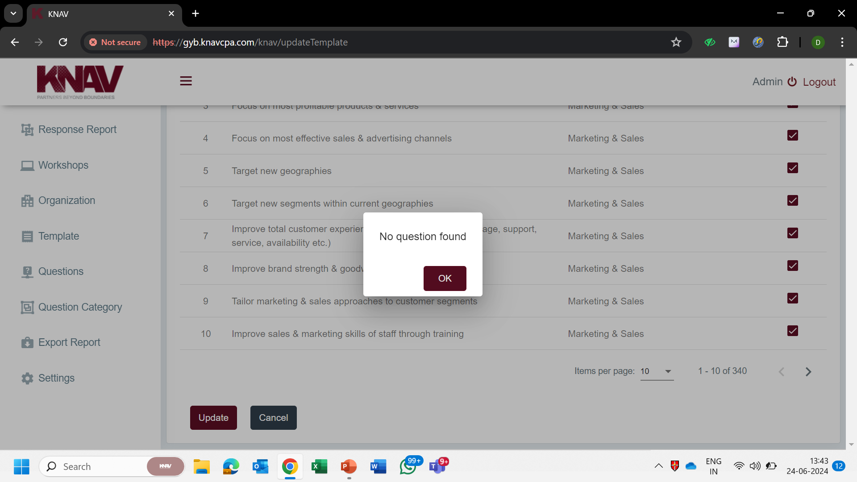
Questionnaire
Addition of Questions in a Template
Existing Functionality and Restrictions
1. We cannot add additional questions once a template is created. Upon the selection of a question, all of the questions end up getting selected and the dialog box showcasing – “No question found” pops up.
Proposed Functionality and Features
1. Herein, selection should allow the user to add the selected question. Further, template once created, should also be editable.

Slide 8
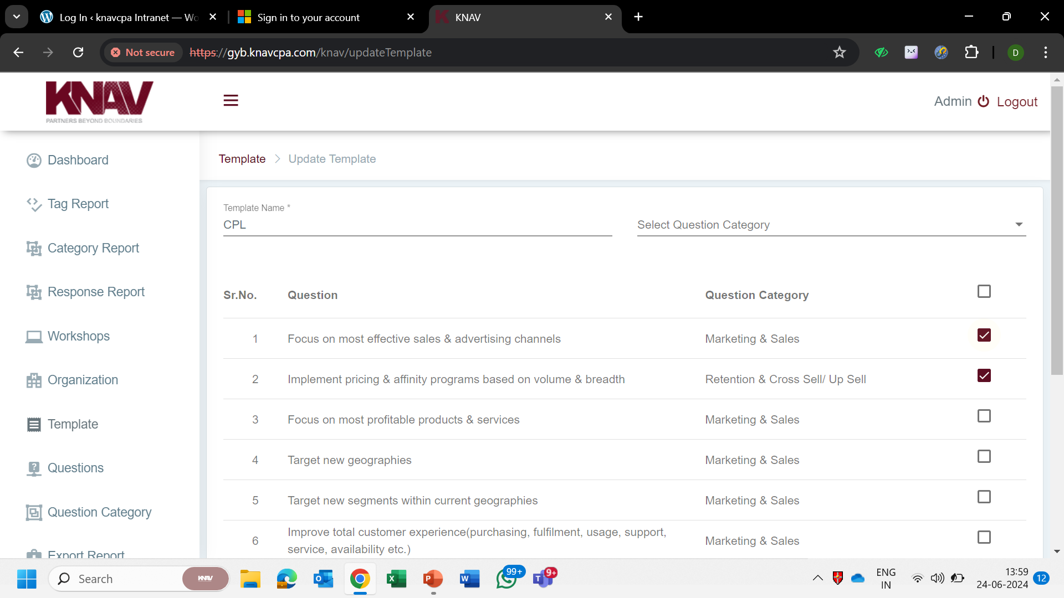
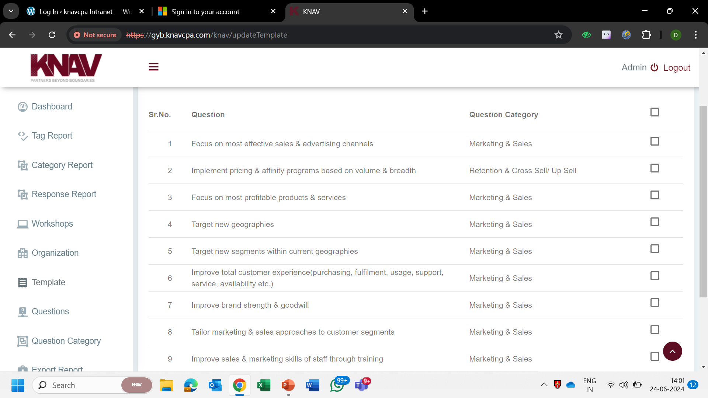
Questionnaire
1
Deletion (Deselection) of Questions in a Template

Slide 9
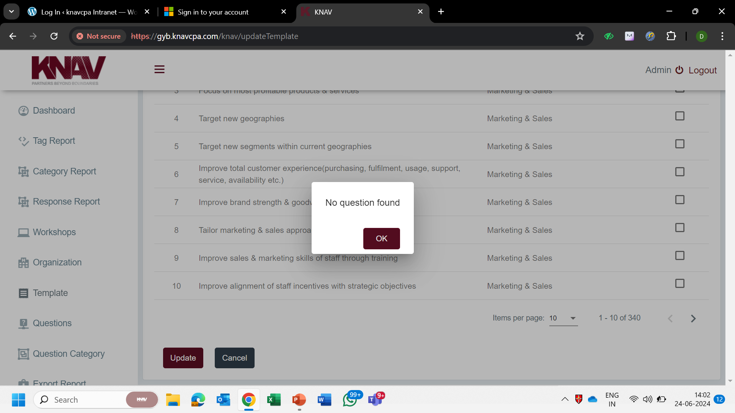
Questionnaire
Deletion (Deselection) of Questions in a Template
Existing Functionality and Restrictions
1. We cannot delete questions once a template is created. Upon the deselection of a question(s), all of the questions end up getting deselected and the dialog box showcasing – “No question found” pops up.
Proposed Functionality and Features
1. Herein, deselection should allow the user to delete the selected question.

Slide 10
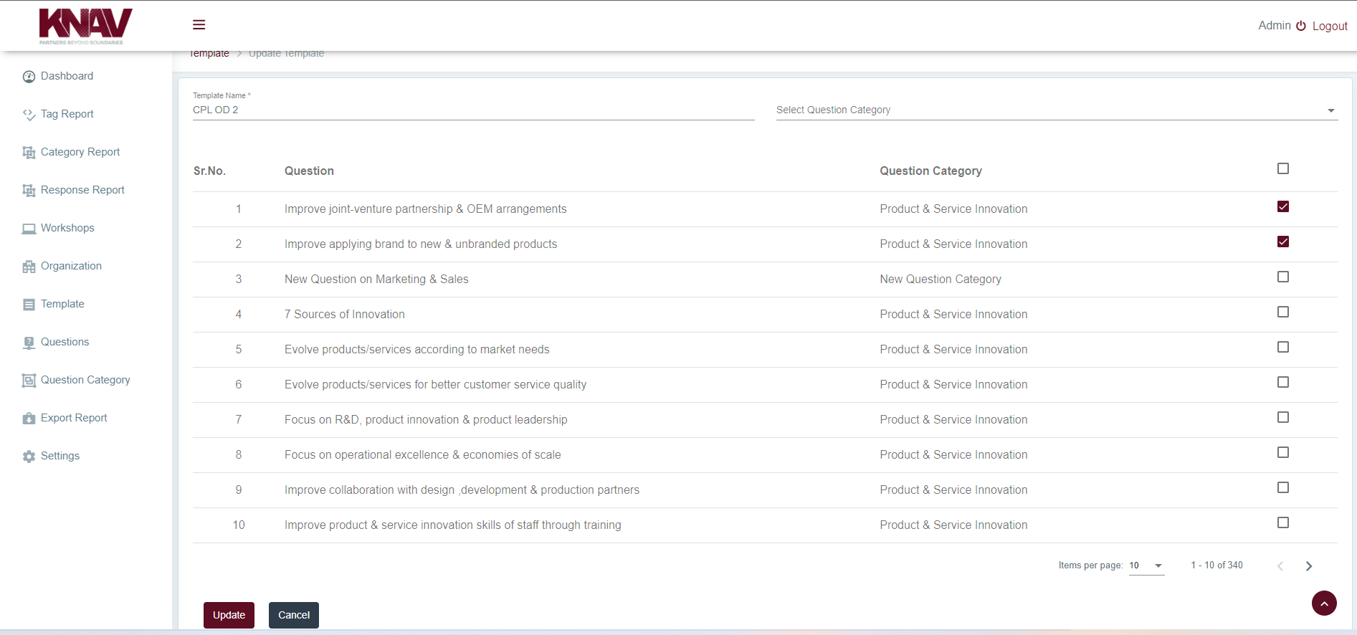
Questionnaire
1
Edition of Questions in a Template
Existing Functionality and Restrictions
1. We cannot make any edits to the Questions in a template. This access is available only in the Questions Sheet.
Proposed Functionality and Features
1. Editing access should be made available for Questions within a Template.

Slide 11
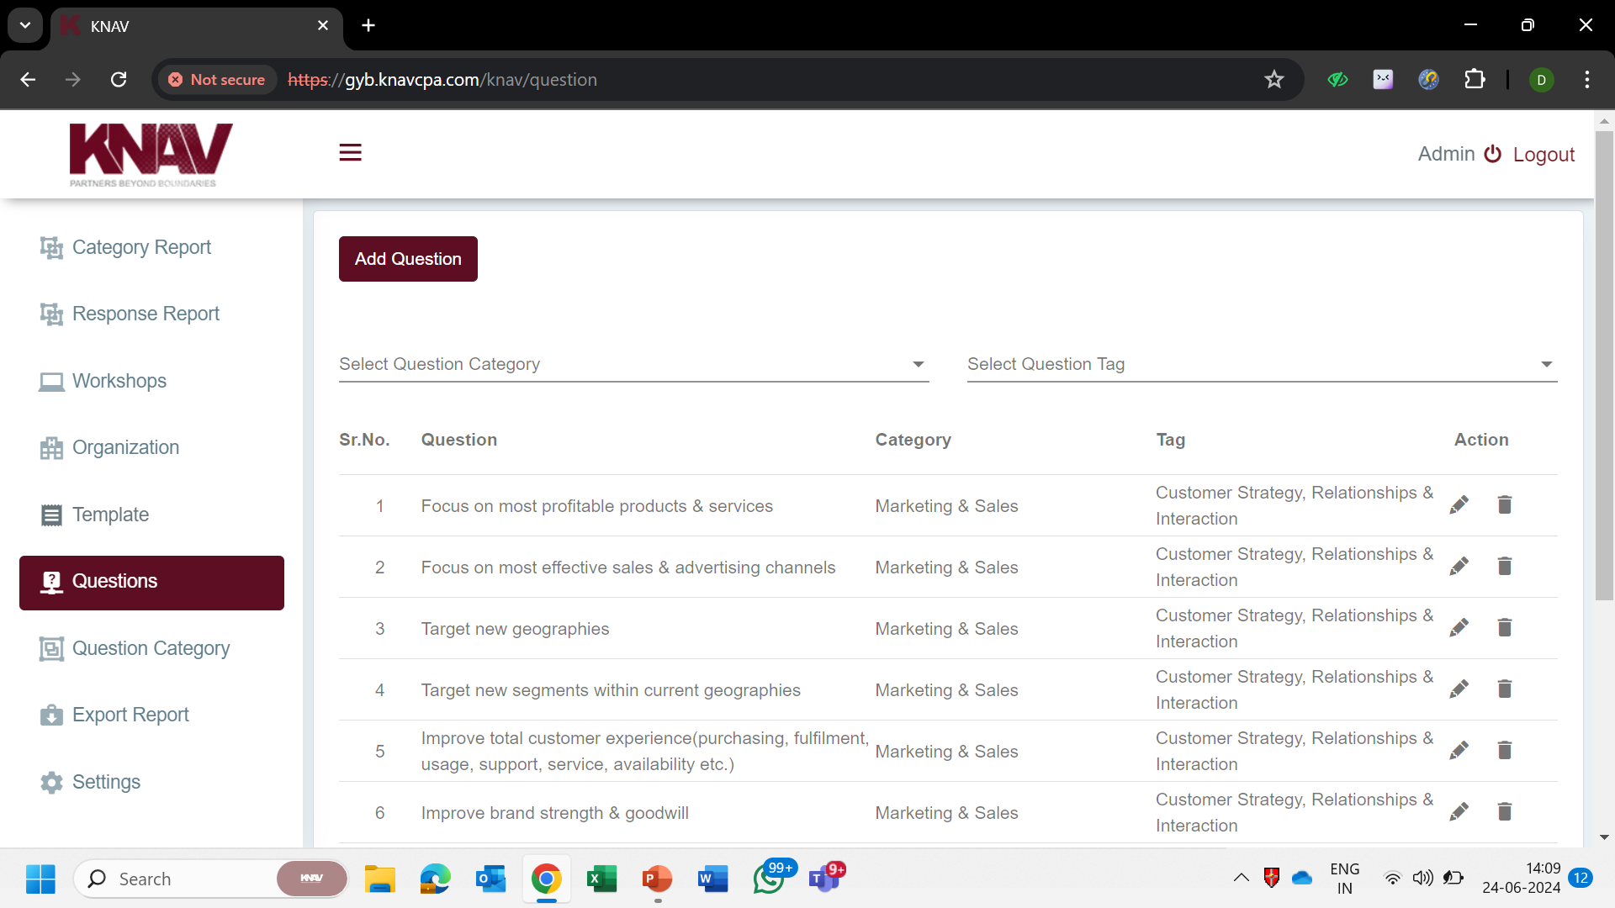
Questionnaire
1
Adding New Questions in a Template
Existing Functionality and Restrictions
1. The functionality to add a question is available in the Questions Sheet. However, it is not available within a template. Template only allows for selection from among the existing questions.
Proposed Functionality and Features
1. The addition of a new question as a functionality should be available under both – the Workshop Templates and the Questions sheet, such that any addition in one Workshop Template does not affect any other Templates and any addition in the Questions Sheet reflects in all templates.

Slide 12
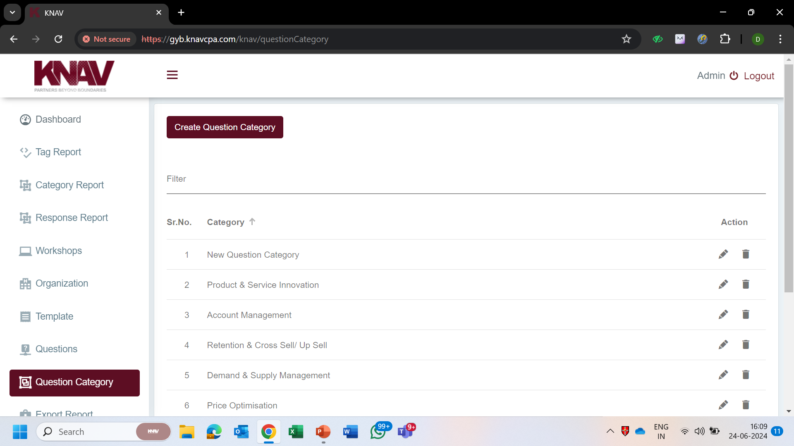
Questionnaire
1
Adding New Question Category(s) in a Template
Existing Functionality and Restrictions
1. The functionality to add a question category is available in the Question Category Sheet. However, it is not available within a template. Template only allows for selection from among the existing categories.
Proposed Functionality and Features
1. The addition of a new category as functionality should be available under both – the Workshop Templates and the Question Category sheet, such that any addition in one Workshop Template does not reflect in any other Templates and any addition in the Question Category Sheet reflects in all templates.

Slide 13
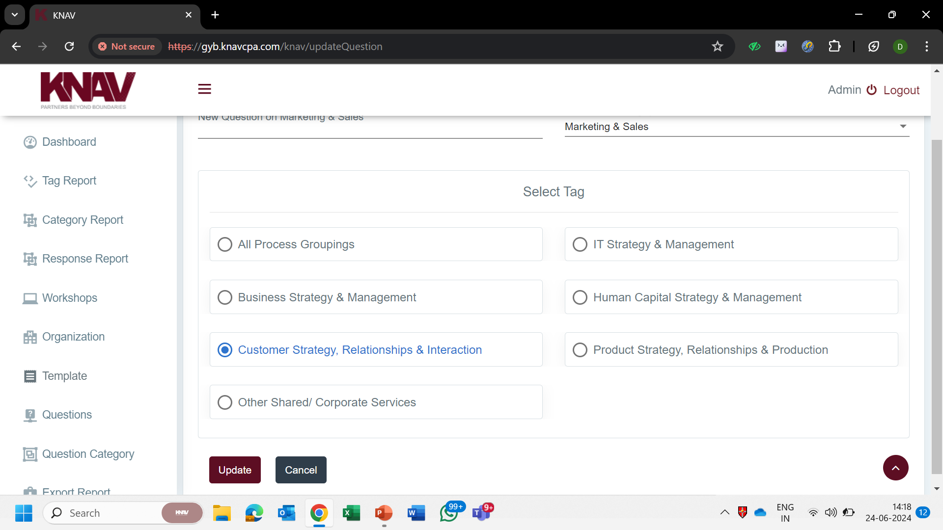
Questionnaire
1
Edition, Addition and Deletion of Category Tags / Question Tags
Existing Functionality and Restrictions
1. Current functionality does not permit any addition, deletion or edition of Category / Question Tags.
Proposed Functionality and Features
1. Edit, Delete and Add options should be extended for Category / Question Tags as well. Furthermore, multiple tags should be allowed for the same question.

Slide 14
Proposed Framework

Slide 15
Proposed Framework
Backend
The organization creation option shall provide KNAV with a functionality to classify an organization under the “Master Categories” as well as “Category Tags” as presented in the Proposed Framework screenshot. The option of multiple selections under both categories shall be required.
Post the creation of an organization and its classification under the relevant categories, the next functionality in order shall be creation of Pre-OD Workshop. Pre-OD Workshop shall have options to add details such as Associated Organization, Pre-OD Commencement Date/Time, Pre-OD Conclusion Date/Time and Pre-OD Participants Details.
Post the creation of Pre-OD Workshop, the subsequent functionality in line shall be the creation of Pre-OD template, with options to select relevant Questions. These questions shall be selected from a Pre-OD Master Sheet. Furthermore, as highlighted in Slides 6-10, addition, deletion and edition option should be made available for Questions in the template itself.
Post the conclusion of Pre-OD Workshop, KNAV should get an option to fill in details for the corresponding OD workshop under the same organization and with same participants. However, the Commencement and Conclusion Dates and Questions Template shall be different.
In line with the hierarchy highlighted in the creation of Pre-OD template, creation of an OD template shall present the users with an option to select the relevant Business Functions and subsequently the Questions from the Master Sheet. This shall be coupled with added functionalities to add new business functions and new questions within the template, delete business functions and questions within the template as well as edit business functions and questions within the template.
Frontend
Additionally, on the front-end, we have the following changes primarily:
The Pre-OD Workshop shall reflect on the frontend for the defined time frame. Post that time, Pre-OD shall not be accessible. The response formats for Pre-OD Workshop on frontend shall be textual as well as multiple choice.
Under the existing system, responders only get to answer from among the three options (Green, Yellow and Red). Along with the current system, we also wish to have radio buttons (permitting selection of only one option), multiple selection (permitting selection of more than one option) and textual answers as response formats.
We desire to have a system wherein for every section, the responder shall be able to have a “save progress” option and a “submit option”. Saved progress shall allow the responder to make changes. Submitted result shall not grant this permission.
Rather than exposing the responder to all sections (i.e. Pre-OD Questionnaire, Vision & Mission Keywords, OD Questionnaire, Actionable and OD Feedback) at once, we can have one section leading to another.

Slide 16
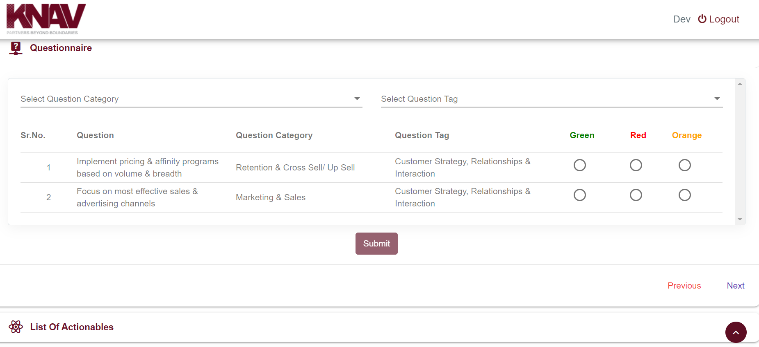
Front-End Changes
1
Questions Display at Front-end
Existing Functionality and Restrictions
1. The user is being exposed to the questions per their questions category and tags.
Proposed Functionality and Features
1. Front-end user should have visibility to questions as per the new format laid out in Slide 14, i.e. Business Function should be the criteria.

Slide 17
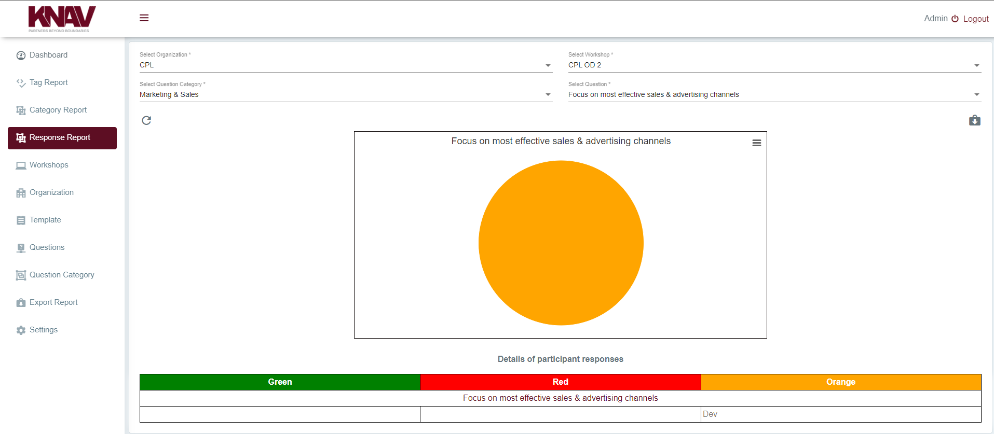
Backend Response Sheet
1
Responses by Questions, Business Functions and Participants with Multiple Download Formats
Existing Functionality and Restrictions
1. Currently, we have an option to view the responses by Question Category and subsequently, the specific Question under that particular Question Category.
Proposed Functionality and Features
1. We desire to have viewing options in terms of Business Functions, Questions and Participants and in any combination of these three divisions. Additionally, export option should be supported in PDF and Excel versions.

